Slide 1
BIG DATA AND THE NEW EU DATA PROTECTION REGULATION

Slide 2
DATA, BIG DATA AND PERSONAL DATA
From a legal point of view there is no single definition for the term “data”. In a wide sense it is used to refer to (any) information, or to the representation of such information, often in combination with it being stored on a computer.
In the digital economy the term “Big Data” is often use with reference to large amounts of different types of data, produced at high speed from multiple sources, whose handling and analysis require new and powerful processors and algorithms.

Slide 3
DATA, BIG DATA AND PERSONAL DATA
Characteristics of Big Data = Volume, Velocity, Variety and Veracity.
Personal data is defined in Article 2 (a) of Directive 95/46/EC (Data Protection Directive) as “any information relating to an identified or identifiable natural person”.
Big Data may include personal data and non-personal data.

Slide 4
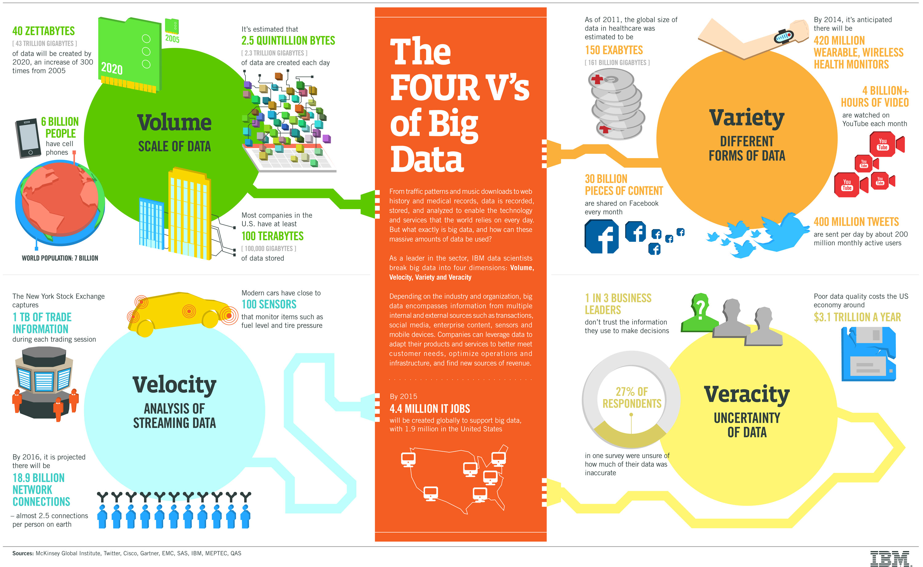
CHARACTERISTICS OF BIG DATA

Slide 5
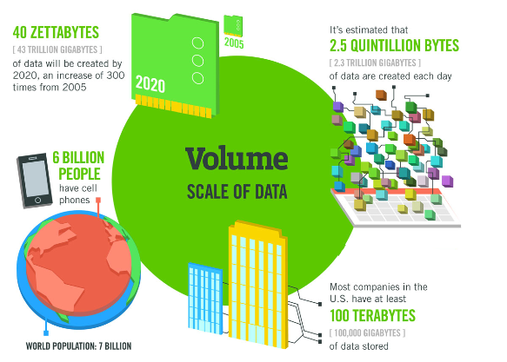
CHARACTERISTICS OF BIG DATA: VOLUME
Volume refers to the vast amounts of data generated every second.
Example, on Facebook alone we send 10 billion messages per day, click the “like” button 4.5 billion times and upload 350 million new pictures each and every day.

Slide 6
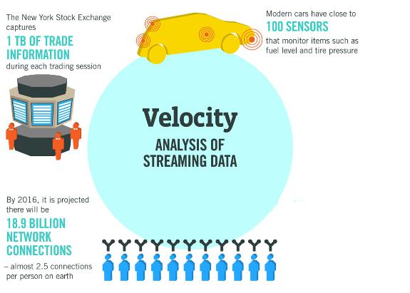
CHARACTERISTICS OF BIG DATA: VELOCITY
Velocity refers to the speed at which new data is generated and the speed at which data moves around.
Big data technology now allows us to analyse the data while it is being generated without ever putting it into databases.

Slide 7
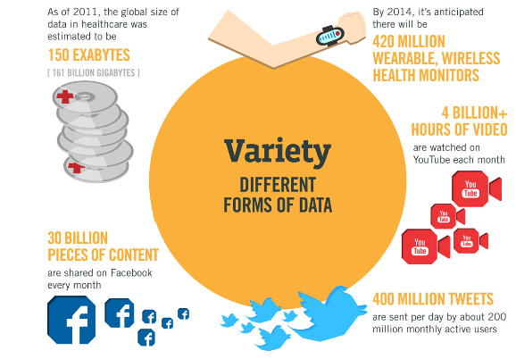
CHARACTERISTICS OF BIG DATA: VARIETY
Variety refers to the different types of data we can now use.
With big data technology we can now harness differed types of data including messages, social media conversations, photos, sensor data, video or voice recordings and bring them together with more traditional, structured data.

Slide 8
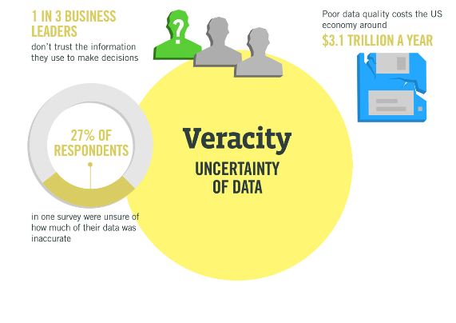
CHARACTERISTICS OF BIG DATA: VERACITY
Veracity refers to the messiness or trustworthiness of the data. With many forms of big data, quality and accuracy are less controllable, for example Twitter posts with hashtags, abbreviations, typos and colloquial speech.
Big data and analytics technology now allows us to work with these types of data.

Slide 9
CATEGORIES OF DATA
Data may be differentiated by whether they are “structured” or not.
Structured data is based on a model that defines a number of fields, what type of data these fields contain and how they relate. Consumer address data base containing information related to each consumer’s name, surname, address, age, phone numbers, etc. is an example of structured data.
Unstructured data does not follow a specific model and needs different processing in order to become of commercial value.

Slide 10
CATEGORIES OF DATA
Moreover, Data can be differentiated by the way it is gathered:
Voluntary basis, e.g. Social networks as well as social communication services.
By tapping sources (openly) available on the internet or by observing the user’s behaviour, even without his or her knowledge.
By inferring information using already existing data.

Slide 11
DATA AND ECONOMIC ACTIVITIES
Customer data represent a precious source of information for any undertaking, interested in learning about customers’ interests in order to improve its products, offer personalized services as well as to target advertisements.
Technological changes of the digital economy strengthened the possibilities to collect, process and use for commercial reasons data in almost every sector. Therefore, more attention is paid to the economic advantages of using data to promote the position of an undertaking.

Slide 12
DATA AND ECONOMIC ACTIVITIES
If on the one hand the collection and use of greater volumes of data may raise competition concerns in some cases, on the other hand it is also a mechanism for the improving services and increasing economic efficiency:
Improvements to products or services: Data can help to improve an undertaking’s product or service. E.g. Websites gather detailed information on the user’s journey through their site and use this information in order to identify parts used more intensively or to minimize technical problems.

Slide 13
DATA AND ECONOMIC ACTIVITIES
New business opportunities: By reusing data gathered in the context of one service for a different purpose, undertakings provide services based on these same data. E.g. mobility data generated by mobile network operators are used by navigation service providers to better show traffic jams and suggest routes.
Target-oriented business models: Data can also be used to better target potential customers. As a consequence, companies may reduce their advertising costs by getting closer to addressing only their target audience.

Slide 14
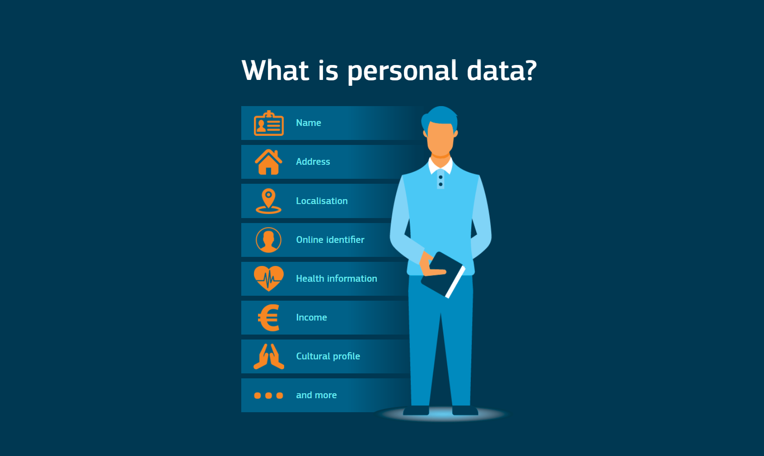
PERSONAL DATA

Slide 15
CATEGORIES OF PERSONAL DATA
(mere) personal data: any information relating to individuals who are or can be identified, even indirectly, by reference to any other information, including a personal identification number.
sensitive data: personal data allowing the disclosure of racial or ethnic origin, religious, philosophical or other beliefs, political opinions, membership of parties, trade unions, associations or organizations of a religious, philosophical, political or trade unionist character, as well as personal data disclosing health and sex life.

Slide 16
CATEGORIES OF PERSONAL DATA
judicial data: any data relating to the database of criminal convictions (“casellario giudiziale”), administrative sanctions arising from a crime and the relevant pending proceedings, as well as the quality of accused or investigated for criminal offences.

Slide 17
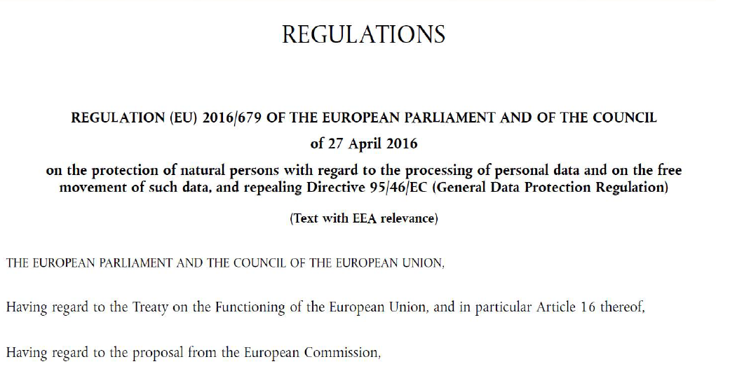
GENERAL DATA PROTECTION REGULATION

Slide 18
GENERAL DATA PROTECTION REGULATION
The General Data Protection Regulation (GDPR) (EU) 2016/679 is a regulation in EU law on data protection and privacy for all individuals within the European Union (EU) and the European Economic Area (EEA).
It also addresses the export of personal data outside the EU and EEA. The GDPR aims primarily to give control to citizens and residents over their personal data and to simplify the regulatory environment for international business by unifying the regulation within the EU.

Slide 19
GENERAL DATA PROTECTION REGULATION
The GDPR includes detailed rules about what you must tell individuals about your processing of personal data. This includes, among other things:
Information about why the personal data is being processed.
How long the data will be stored (or, if that is not possible, the criteria used to determine that period).
With whom the personal data will be shared.
Whether the personal data will be transferred outside the European Economic Area.

Slide 20
GENERAL DATA PROTECTION REGULATION
Superseding the Data Protection Directive (DPD) 95/46/EC, the regulation contains provisions and requirements pertaining to the processing of personally identifiable information of data subjects inside the European Union, and applies to all enterprises, regardless of location, that are doing business with the European Economic Area.

Slide 21
GDPR VERSUS THE PREVIOUS DPD
There are three major differences between the GDPR and the previous DPD:
GDPR is a Regulation, while DPD is a Directive. A Directive is a set of general rules which is only enforceable when each EU country transfer them into their national law. On the other hand a Regulation is similar to national laws, the only difference being it covers the whole region of EU. Therefore the GDPR will be enforceable in May 2018 without any additional legislative process.

Slide 22
GDPR VERSUS THE PREVIOUS DPD
GDPR explicitly states that companies violating the regulation is subject to a penalty up to 20 million euro or 4% of their global revenue, whichever is higher. (Article 83, Paragraph 5)
GDPR is not limited to companies with their headquarters set in EU, but to all companies that are holding data from EU citizen. (Article 3, Paragraph 1)

Slide 23
WHAT WILL CHANGE UNDER THE GDPR?
The Regulation updates and modernises the principles enshrined in the 1995 Data Protection Directive to guarantee privacy rights. It focuses on:
reinforcing individuals' rights
strengthening the EU internal market
ensuring stronger enforcement of the rules
streamlining international transfers of personal data
setting global data protection standards

Slide 24
WHAT WILL CHANGE UNDER THE GDPR?
The changes will give people more control over their personal data and make it easier to access it. They are designed to make sure that people’s personal information is protected – no matter where it is sent, processed or stored – even outside the EU, as may often be the case on the internet.

Slide 25
REINFORCING INDIVIDUALS’ RIGHTS
Individuals have many rights under the GDPR that organizations must respect. This includes rights to:
access the personal data you hold about them
have their personal data corrected or deleted (the “right to be forgotten”)
ask you to stop processing their personal data
object to direct marketing
revoke consent for certain uses of their personal data.

Slide 26
THE IMPACT OF GDPR ON BIG DATA
Here’s some of the impact GDPR can have:
Increased necessity for reviewing and modifying organizational processes, applications, and systems
A need for new and more stringent privacy and security requirements to be addressed
And even potential fines up to 4% of annual revenue turnover and legal costs and recourse

Slide 27
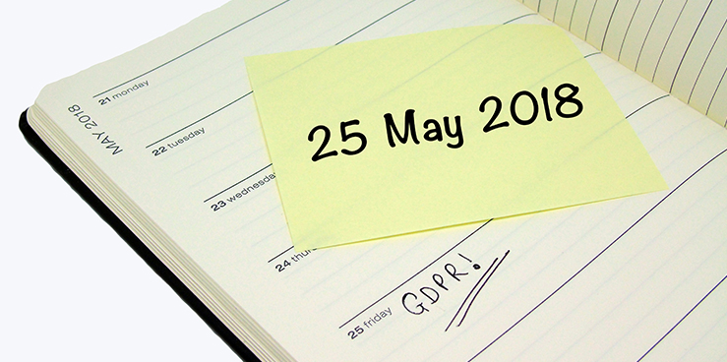
WHEN DOES THE GDPR TAKE EFFECT?

Slide 28
WHEN DOES THE GDPR TAKE EFFECT?
The GDPR has taken effect on May 25, 2018.
The GDPR actually became law in April 2016, but given the significant changes some organizations will need to make to align with the regulation, a two-year transition period was included.
Organizations should not expect any grace period from regulators beyond May 25, 2018.

Slide 29
WHO DOES THE GDPR APPLY TO?
The GDPR is applicable to organizations of all sizes and all industries. Specifically, the GDPR applies to:
processing of anyone’s personal data, if the processing is done in the context of the activities of an organization established in the EU
processing of personal data of individuals who reside in the EU by an organization established outside the EU, where that processing relates to the offering of goods or services to those individuals or to the monitoring of their behaviour.

Slide 30
MAIN REQUIREMENTS OF THE GDPR
The GDPR imposes a wide range of requirements on organizations that collect or process personal data, including a requirement to comply with six key principles:
Transparency, fairness, and lawfulness in the handling and use of personal data. You will need to be clear with individuals about how you are using personal data and will also need a “lawful basis” to process that data.
Limiting the processing of personal data to specified, explicit, and legitimate purposes. You will not be able to re-use or disclose personal data for purposes that are not “compatible” with the purpose for which the data was originally collected.

Slide 31
MAIN REQUIREMENTS OF THE GDPR
Minimizing the collection and storage of personal data to that which is adequate and relevant for the intended purpose.
Ensuring the accuracy of personal data and enabling it to be erased or rectified. You will need to take steps to ensure that the personal data you hold is accurate and can be corrected if errors occur.

Slide 32
MAIN REQUIREMENTS OF THE GDPR
Limiting the storage of personal data. You will need to ensure that you retain personal data only for as long as necessary to achieve the purposes for which the data was collected.
Ensuring security, integrity, and confidentiality of personal data. Your organization must take steps to keep personal data secure through technical and organizational security measures.

Slide 33

KEY TERMS OF GDPR

Slide 34
KEY TERMS OF GDPR
Article 4 of the GDPR includes a list of defined terms used in the regulation. Several are particularly important:
“Controller” means the natural or legal person, public authority, agency or other body which, alone or jointly with others, determines the purposes and means of the processing of personal data.
“Processor” means a natural or legal person, public authority, agency, or other body which processes personal data on behalf of the controller.

Slide 35
KEY TERMS OF GDPR
“Personal data” means any information relating to an identified or identifiable natural person (“data subject”); an identifiable natural person can be identified, directly or indirectly, in particular by reference to an identifier such as a name, an identification number, location data, an online identifier, or to one or more factors specific to the physical, physiological, genetic, mental, economic, cultural, or social identity of that natural person.

Slide 36
KEY TERMS OF GDPR
“Processing” means any operation or set of operations which is performed on personal data or on sets of personal data, whether or not by automated means, such as collection, recording, organisation structuring, storage, adaptation or alteration, retrieval, consultation, use, disclosure by transmission, dissemination or otherwise making available, alignment or combination, restriction, erasure or destruction.

Slide 37
KEY TERMS OF GDPR
“Pseudonymisation” means the processing of personal data in such a manner that the personal data can no longer be attributed to a specific data subject without the use of additional information, provided that such additional information is kept separately and is subject to technical and organisational measures to ensure that the personal data are not attributed to an identified or identifiable natural person.

Slide 38
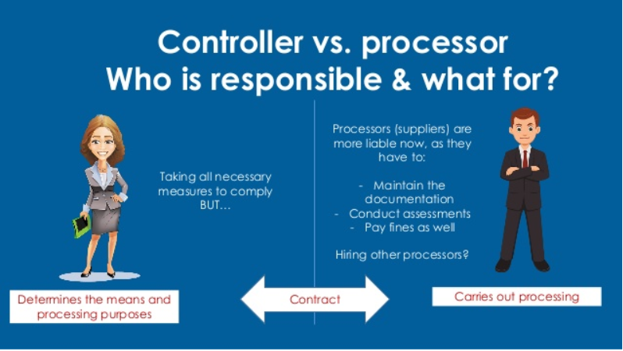
CONTROLLER VERSUS PROCESSOR

Slide 39
WHAT IS A DATA CONTROLLER?
A Data controller is the natural or legal person, public authority, agency or other body which, alone or jointly with others, determines the purposes and means of the processing of personal data. Data controllers can be either individuals or “legal persons” such as companies, Government Departments and voluntary organisations.

Slide 40
WHAT IS A DATA CONTROLLER?
Examples of cases where the data controller is an individual include general practitioners, pharmacists, politicians and sole traders, where these individuals keep personal information about their patients, clients, constituents etc.
Real world example of a data controller - a bank who collects and maintains records of their customer when new accounts are set-up.

Slide 41
WHAT IS A DATA PROCESSOR?
A data processor is anyone who processes personal data on behalf of the data controller (excluding the data controller’s own employees). This could include storage of the data on a third party’s servers, or appointing a data analytics provider.
Real world example of a data processor - a marketing team who are contracted by company A to send marketing content to their clients. The marketing company in this regard is the Data Processor as they are provided with the data by company A for a specific use.

Slide 42
PERSONAL DATA DEFINED BY GDPR
Let’s start with how the new laws look at “personal data”. Personal data is anything that contains:
Directly identifying information such as a person’s name, surname, phone numbers, etc.
Pseudonymous data or non-directly identifying information, which does not allow the direct identification of users but allows the singling out of individual behaviours.

Slide 43
PERSONAL DATA DEFINED BY GDPR
The GDPR establishes a clear distinction between directly identifying information and pseudonymous data. The GDPR encourages the use of pseudonymous information and expressly provides that “the application of pseudonymisation to personal data can reduce the risks to the data subjects concerned and help controllers and processors to meet their data-protection obligations”.

Slide 44

SENSITIVE DATA DEFINED BY GDPR

Slide 45
SENSITIVE DATA DEFINED BY GDPR
Article 9(2) sets out the circumstances in which the processing of sensitive personal data which is otherwise prohibited, may take place.
The following categories of data are considered “sensitive”, as set out in Article 9(1):
• racial or ethnic origin
• political opinions
• religious or philosophical beliefs
• trade union membership
• data concerning health or sex life and sexual orientation
• genetic data (new)
• biometric data where processed to uniquely identify a person (new)

Slide 46
THANK YOU

